Slide 1
HEALTHSOUTH FRAUD
LESSONS LEARNED

Slide 2
ETHICS FIRST

Slide 3
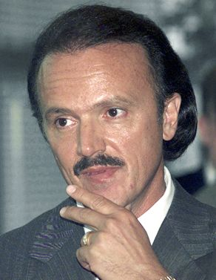
Richard M. Scrushy
Notes:
3

Slide 4
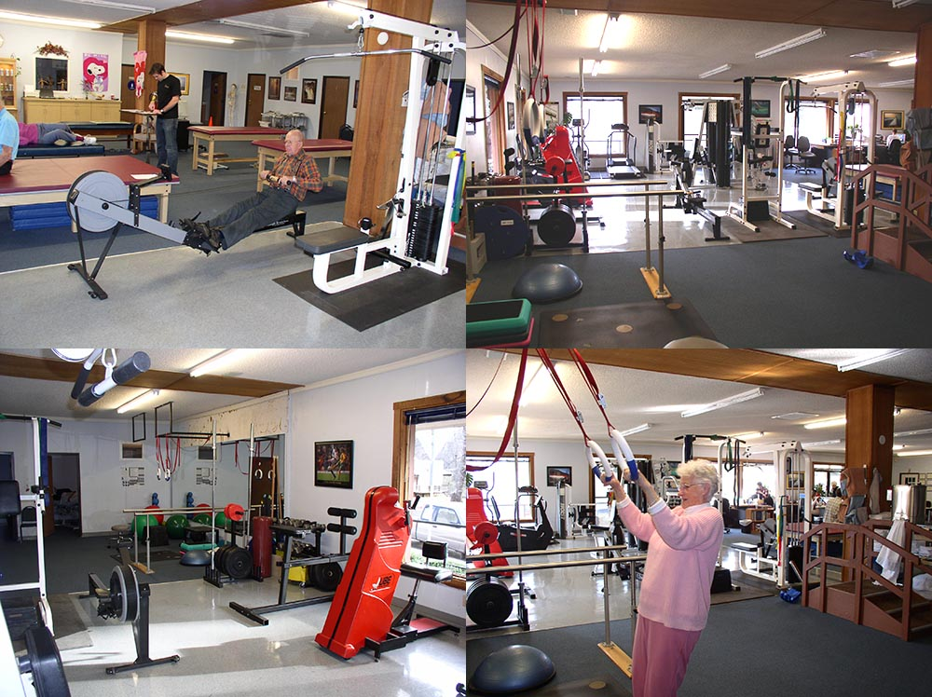
Notes:
4

Slide 5
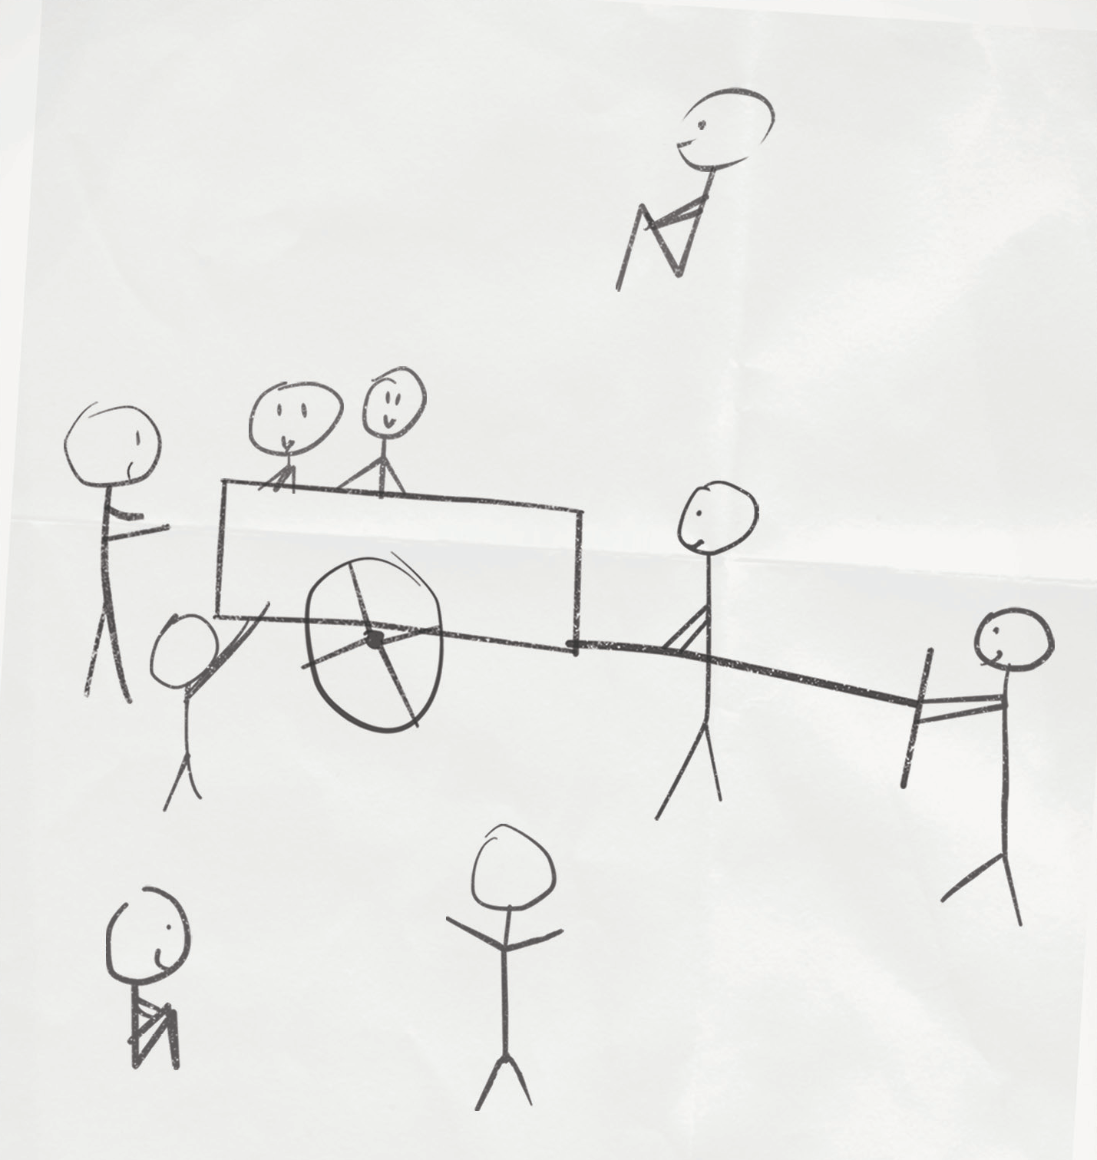
Notes:
5

Slide 6
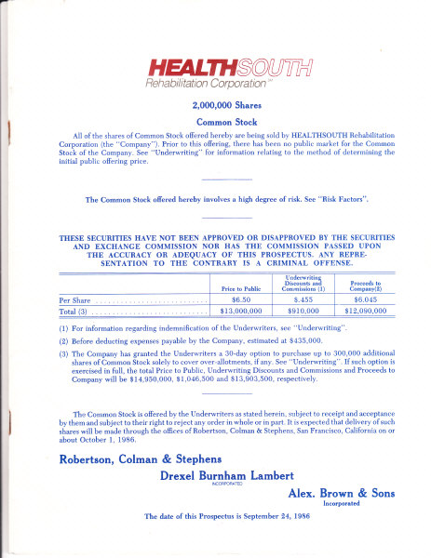
Notes:
6

Slide 7
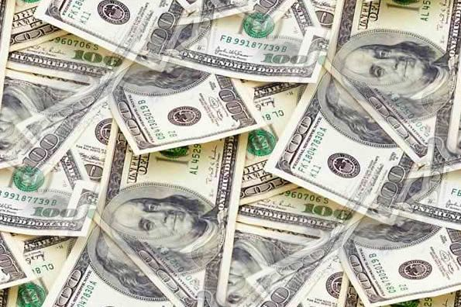

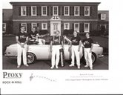
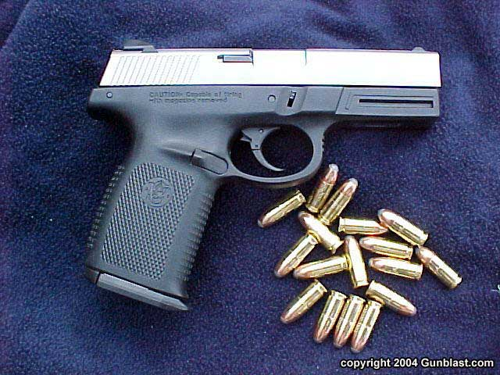

Notes:
7

Slide 8
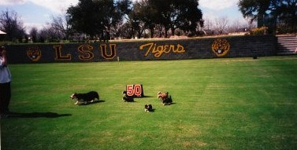
Notes:
8

Slide 9
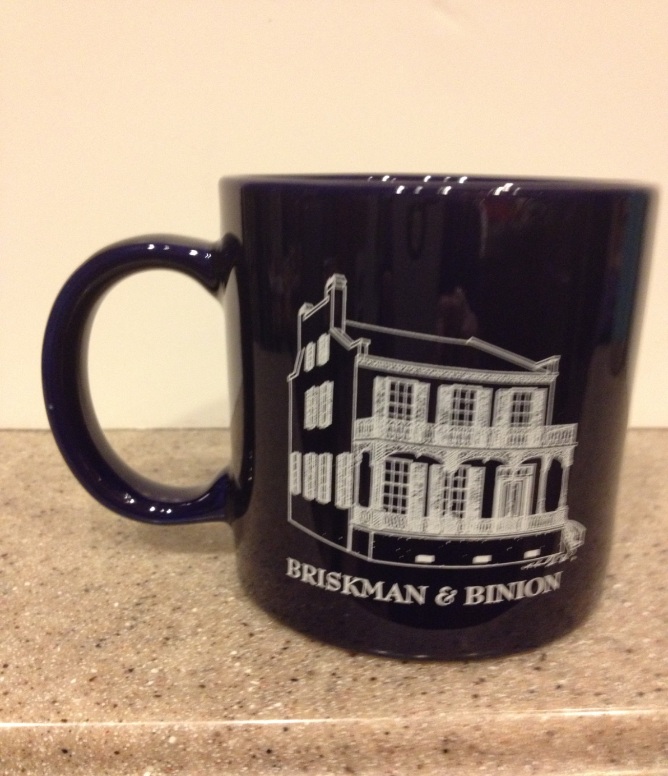
$100,000 Coffee Mug

Slide 10

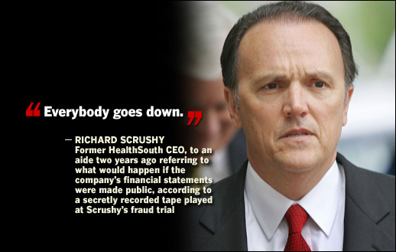
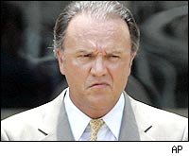


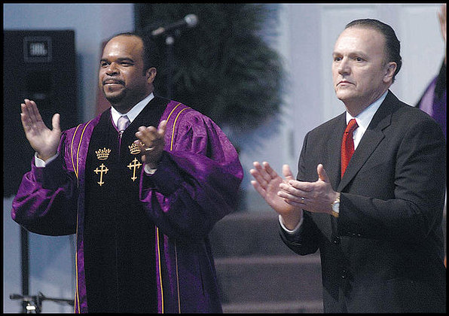


Notes:
10

Slide 11
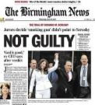
Notes:
11

Slide 13
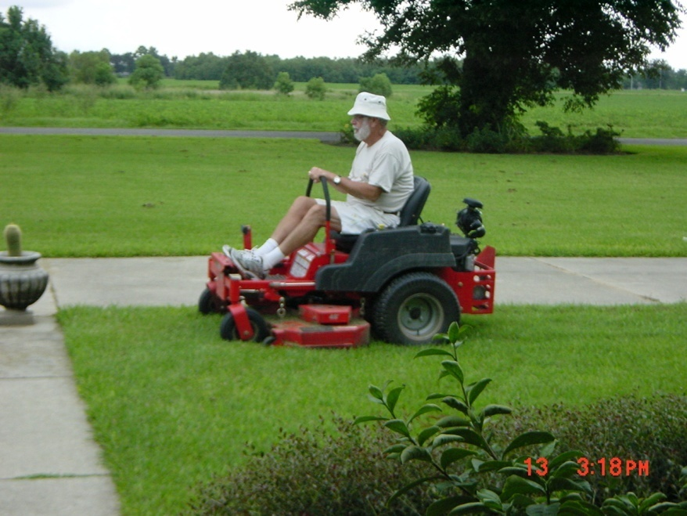

Slide 14
SUCCESS
In 1806 Webster’s Dictionary defined success as “being generous, prosperous, healthy and kind.”
Today, Webster’s defines success as “the attainment of wealth, fame and rank.”

Slide 15
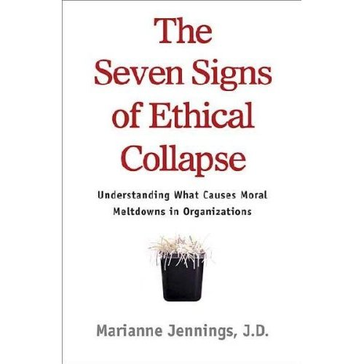
Notes:
15

Slide 16
#1 Pressure to maintain those
Numbers
Notes:
16

Slide 17
#1 Pressure to maintain those numbers
#2 Fear and Silence
Notes:
17

Slide 18
#1 Pressure to maintain those numbers
#2 Fear and Silence
#3 Young ‘Uns and a Bigger-
than-Life CEO
Notes:
18

Slide 19
#1 Pressure to maintain those numbers
#2 Fear and Silence
#3 Young ‘Uns and a Bigger-than-Life CEO
#4 Weak Board
Notes:
19

Slide 20
#1 Pressure to maintain those numbers
#2 Fear and Silence
#3 Young ‘Uns and a Bigger-than-Life CEO
#4 Weak Board
#5 Conflicts
Notes:
20

Slide 21
#1 Pressure to maintain those numbers
#2 Fear and Silence
#3 Young ‘Uns and a Bigger-than-Life CEO
#4 Weak Board
#5 Conflicts
#6 Innovation Like No Other
Notes:
21

Slide 22
#1 Pressure to maintain those numbers
#2 Fear and Silence
#3 Young ‘Uns and a Bigger-than-Life CEO
#4 Weak Board
#5 Conflicts
#6 Innovation Like No Other
#7 Goodness in Some Areas
Atones for Evil in Others
Notes:
22

Slide 23

Notes:
23

Slide 24
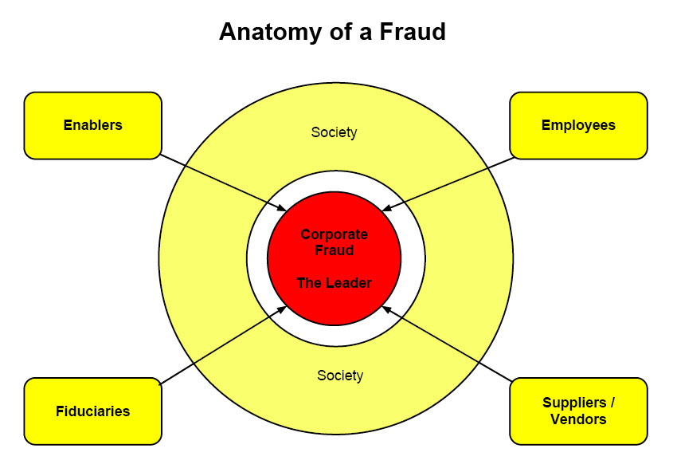

Slide 25
Why Did the Auditors Miss It?
Dominating CEO who the auditors wanted to please
Corroboration among participants
Lack of access to IT systems
Our knowledge of auditors techniques
A “prize” client yielding huge fees
Ineffective Board of Directors
Auditors accepted flimsy answers
Healthsouth never changed Auditors

Slide 26
Ripple Effects of Fraud
Medicare Fraud
Bank Fraud
Comprised Due Diligence, resulting in bad acquisitions
The need to make acquisitions to cover up the fraud
Budget process and financial analysis compromised
Employees morale declines as they become suspicious
Overpayment of income and property taxes

Slide 27
Factors Contributing to Healthsouth Fraud
The VP of internal auditing reported directly to CEO.
CEO became a darling of Wall Street before Wall Street knew his true colors.
The Board of Directors simply did not do their job.
Accounting practices in the for profit sector of Healthcare had a very poor track record.
Wall Street’s desire to “do deals” pushes companies to the edge of honesty.
Wall Street Analyst rely too heavily on data from the companies they cover.
Companies put lots of lipstick on the pig.

Slide 28
Why did Aaron Beam take part in the fraud at Healthsouth?
It was fun being rich and running with the big dogs.
I was proud of Healthsouth and let myself rationalize that breaking the rules was in the best interest of the company.
I simply was not as ethical as I should have been.
I gave into Wall Street pressures.
I let Richard Scrushy intimidate me. I was a coward.
Like a fool, in the heat of the battle, I let myself believe we would do it only once.
Pressure to please everyone without concern for the long term problems the fraud would create.
In the beginning, I did not believe I would be caught.
Notes:
28

Slide 29
Recent Quote by the Dean of the Harvard Business School.
Character development is similar to the development of knowledge or wisdom-it is a lifelong process.

Slide 30
What is right is right, even if no one is doing it.
What is wrong is wrong, even if everyone is doing it.

Slide 31
ETHICS FIRST

Slide 32
In what year did the criminal fraud begin at HealthSouth?
Text a KEYWORD to 22333 or Submit responses at PollEv.com
ANSWERS | KEYWORD
a. 1986 | 298632
b. 2003 | 298639
c. 1996 | 298640
d. 1990 | 298641

Slide 33
Which one of these is not part of the fraud triangle?
Text a KEYWORD to 22333 or Submit responses at PollEv.com
ANSWERS | KEYWORD
a. opportunity | 299141
b. rationalization | 299143
c. motive | 299144
d. lack of information | 299145

Slide 34
The first Sarbanes-Oxley trial was
Text a KEYWORD to 22333 or Submit responses at PollEv.com
ANSWERS | KEYWORD
a. Enron | 299166
b. Tyco | 299167
c. HealthSouth (Richard Scrushy) or Bernie Madoff | 299169

