Slide 1
TVA Regulatory Update
Cameron Heck, Senior Manager, Regulatory Policy & Compliance
May 17, 2018

Slide 2
Outline
TVA’s Role as Regulator
Regulatory Landscape
LPC Retail Broadband Deployment Guidance

Slide 3
TVA’s Role as Regulator
But somebody’s gotta do it!

Slide 4
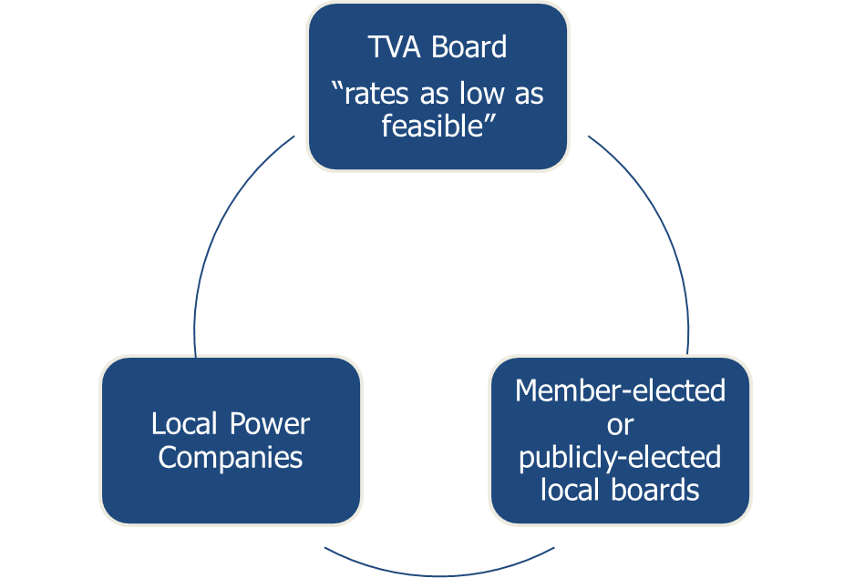
TVA’s Role as Regulator
While state regulatory authority rests on state law, TVA’s regulatory authority rests on the federal TVA Act
As regulators, the TVA Board protects electric ratepayers’ interest in receiving electric service at rates “as low as feasible”

Slide 5
TVA’s Role as Regulator
The 4R’s
Rates as low as feasible (non-profit)
Restricted use of electric system assets and funds
Ratepayers non-discrimination
Rules and regulations
The Valley’s Regulatory Model
Balancing TVA’s regulatory responsibility and oversight with LPC local control

Slide 6
TVA’s Role as Regulator
TVA’s role as regulator is critical to the Valley’s public power model
LPC Accounting Staff and TVA Regulatory Analysts are essential to the integrity of the business model
Consistent implementation and oversight is necessary for regulatory credibility

Slide 7
TVA Regulatory Oversight - Timeline
Strict
Enforcement
Lenient
Enforcement
Beginnings of
Balanced Regulation
Balanced
Regulation
Pre-1992
2006
OIG Report
2008
OIG LPC
Audits start
2011 Board
Resolution on Regulation and
DC formed
2017
DA/DC
merged to RAC
2010
OIG Report
Pre-1992
1992-2006
2007-2011
2011-Present

Slide 8
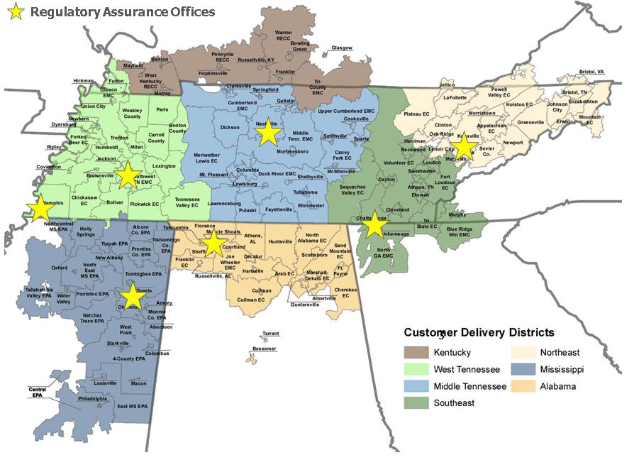
TVA’s Role as Regulator
Provides regulatory assurance and protects the public power model and Valley ratepayers’ interests within TVA’s regulatory framework.
Our team provides:
Oversight of TVA’s retail regulatory standards
Policy development and guidance
Power contract regulatory compliance
Retail rate analysis
Financial data integrity assurance
A challenging, engaged, mission-driven workplace environment
Complaint Resolution Process management

Slide 9
Regulatory Landscape
Ignoring Compliance is
RISKY BUSINESS

Slide 10
Regulatory Landscape
Financial Thresholds
LPCs with cash ratios exceeding 33% are classified as having high cash reserves
TVA will notify identified LPCs and request 1) justification for cash level or 2) capital spending plans to reduce cash
Pole Attachment Rate Implementation Status
As of January 1, 2018, all LPCs should be undertaking efforts to comply with TVA’s pole attachment regulation
128 contract amendments executed; 127 LPC pole attachment rates approved
Compliance testing to begin in FY2019
Century Link and AT&T 2009 TVPPA joint use agreements approved

Slide 11
Regulatory Landscape
Distributed Energy Resources (DER)
DER market disrupters and consumer demands create business challenges for TVA and LPCs
DER activities will be evaluated in light of TVA’s regulatory framework
Accounting Updates
DARS Focus Groups – reviewing feedback; more on project details in coming months
District Annual Report Training to be offered June 4-15
GASB-75 impact to FY 18 Annual Reports

Slide 12
Portfolio Planning Overview
Transitions analyst work plans from a 100% coverage approach to a more customized approach designed to help improve an LPC’s regulatory and financial health.
Optimizes available resources and provides a greater level of assurance by prioritizing analyst execution based on risk factors specific to each LPC.

Slide 13
2018 Regulatory Timeline
June 4-15
FY19
September 15
August 15
July
August 30
LPC Annual Report Training | High Cash | Annual Report | Pole Attachment Rate Template | High Cash | Pole Attachment Compliance Testing
District training for LPC accounting staff | Review list of newly identified LPCs with CD; request 1:1s; issue regulatory letter | LPCs submit annual report to TVA through DARS | LPCs submit 2018 pole attachment rate template through Online Connection to produce 2019 pole attachment rates | LPCs submit high cash justification or capital spend plans | TVA begins compliance testing LPC implementation of the TVA-approved pole attachment rate

Slide 14
LPC Retail Broadband Deployment Guidance

Slide 15
Key Areas of TVA’s Regulatory Focus
Rates as low as feasible (non-profit)
Restricted use of electric system assets and funds
Ratepayer non-discrimination
Rules and regulations

Slide 16
Broadband Background
LPCs’ interest to offer broadband service or expand existing services for electric and non-electric purposes has increased.
2017 State of Tennessee approved legislation for cooperatives to engage in broadband.
2003
2 LPCs offered broadband / telecom
Today
2 LPCs currently deploying
20 LPCs expressing interest
Future
26 LPCs offer broadband, telecom, cable, TV, and/or internet services

Slide 17
Regulatory Considerations in Broadband Deployment
The wholesale power contract prohibits the use of electric system funds or assets for non-electric purposes in order to protect ratepayers from the risks associated with non-electric business ventures like broadband.
LPCs may use electric system funds for broadband for electric system purposes (AMI, SCADA). In these situations, the LPC must:
Not commingle funds between the electric department and the LPC’s other departments or lines of business; and
Ensure proper allocation of any joint costs between the electric department and other departments or lines of business.

Slide 18
Regulatory Considerations in Broadband Deployment
Under certain limited circumstances, TVA may agree to the use of reasonable “reserve funds” as a loan or collateral for a loan to an LPC retail broadband division.
These limited circumstances require an interdivision loan agreement between TVA and the LPC to ensure reasonable protections exist for electric ratepayers in the event of loan default or if the business is not successful.
How does TVA determine if such a loan of reserve funds is appropriate and ratepayers are protected?
Collateral and favorable LPC interdivision loan terms (interest rate, etc.)
Broadband business plan evaluated for reasonableness.

Slide 19
TVA Review of Broadband Business Plan
TVA’s review of LPC broadband business plans are limited to:
Strategic purpose Sound business logic Financial targets Internal rate of return Net present value Payback period | Assumptions Costs Revenues Market-share benefits to the electric system Competitive analysis and market risk

Slide 20
LPC/TVA Considerations
To ensure compliance with wholesale power contract provisions, LPCs should engage TVA when considering an investment in broadband, particularly if the LPC intends to use electric system funds for non-electric purposes.
LPCs
Review the proposed business plan for reasonableness.
Under certain circumstances, TVA may agree to the use of electric system funds as a loan to a retail broadband division.
Ensure pole attachment rates and joint costs are allocated between divisions/subsidiary.
TVA
Contact your CSM or Regulatory Analyst to initiate discussions.
Include a 10-yr pro forma of the financials for both electric and broadband.
Pole attachment rates must be calculated according to TVA’s pole attachment calculations and guiding principles.
Ensure any new business or service is consistent with state law.
Submit a business plan to TVA as soon as possible.

Slide 21
Resources
OnlineConnections > Regulatory Assurance Page
Regulatory Assurance:
Regulatory Assurance & Compliance – LPC Regulatory Analysts
Regulatory Policy & Compliance
TVA Restricted Information - Deliberative and Pre-Decisional Privileged

